Slide 1
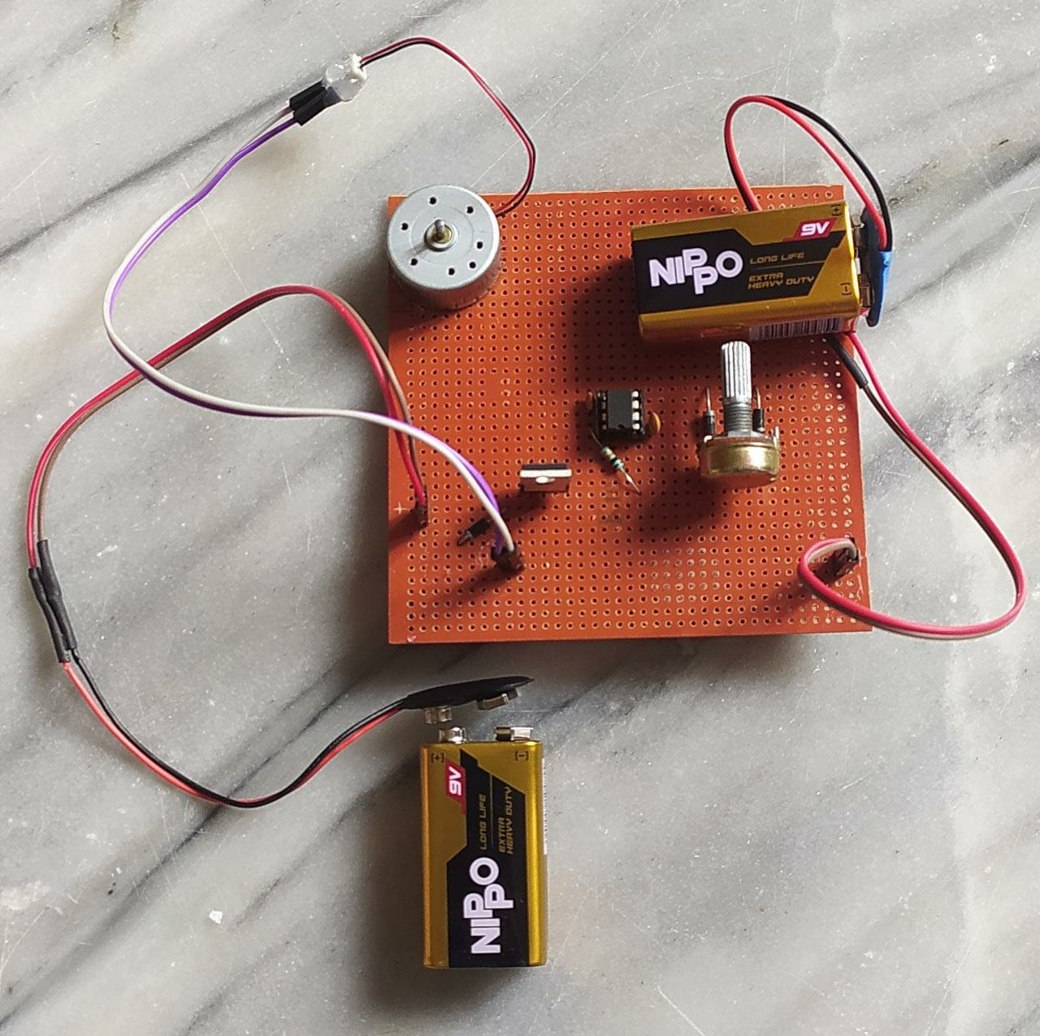
SPEED CONTROL OF DC MOTOR THROUGH PWM
P.SHIVA PRIYA 19K41A04A9
V. RAMU 19K41A0488
Y.RAJASHEKAR 19K41A04A1
KARTHIK 19K41A0484
Mentor : Dr.T. Laxman raj.

Slide 2

ABSTRACT
Pulse width modulation works by switching the power supplied to the motor on and off very rapidly. The DC voltage is converted to a square wave signal, alternating between fully on (nearly 12v) and zero, which gives the motor a series of power “kicks”.
The major reason for using pulse width modulation in DC motor control is to avoid the excessive heat dissipation.
PWM is most efficient and cheap speed control method.

Slide 3
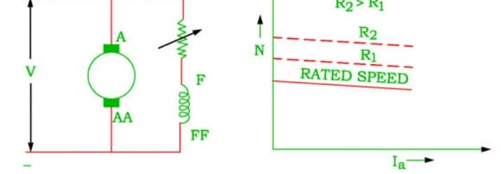
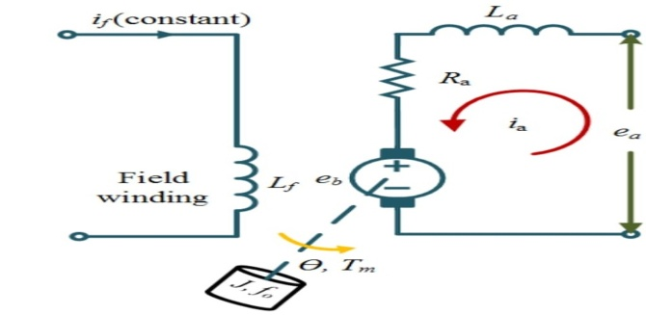
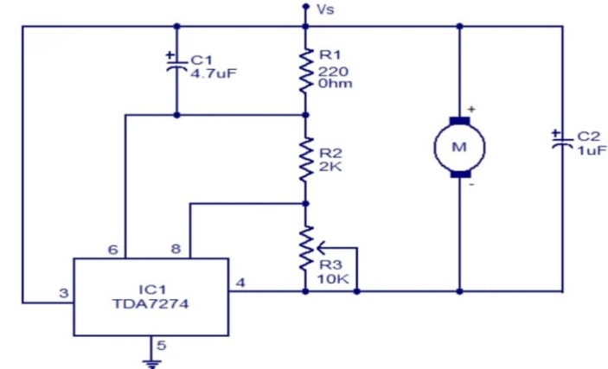
Frequently used methods of speed controlling of dc motor
Flux Control Method
Armature Control Method
Voltage Control Method

Slide 4
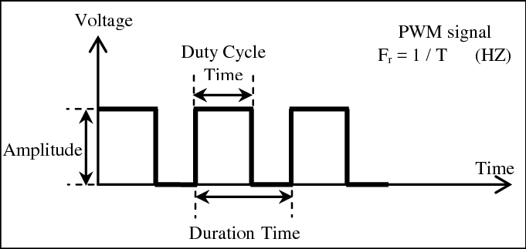
PROPOSED IDEA:
Proposed method is with PWM:
Here the speed pulse train will be based on required input speed, or resistance given.
The advantage of using pwm is, very low heat loss and low cost. Also the circuit response time is fast.

Slide 5
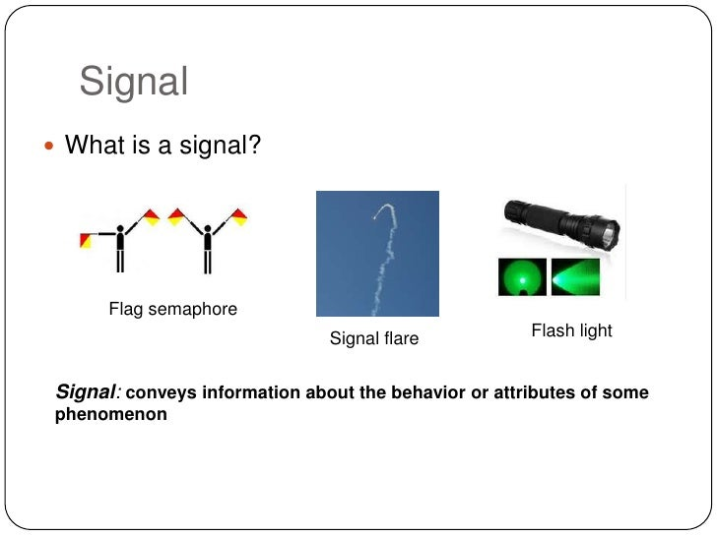
APPLICATIONS OF PWM
1.Drive buzzer with different loudness.
2.Control speed of the motor.
3.Control the direction of a servo.
4.Provide an analog output.
5.Generate audio signal.
6.Telecommunication: Encode message.

Slide 6
ADVANTAGES
1.The consumption of power to the motor is very less.
2.Due to heat there is a less amount of energy is decreased
3.It will allow the fine motor control.
4.The efficiency is up to 90%.
5.Being able to vary their speed with PWM increases the efficiency of the total system by quite a bit. PWM is more effective at controlling motor speeds at low RPM than linear methods.
5.The main advantage of PWM is that power loss in the switching devices is very low. When a switch is off there is practically no current, and when it is on and power is being transferred to the load, there is almost no voltage drop across the switch.

Slide 7
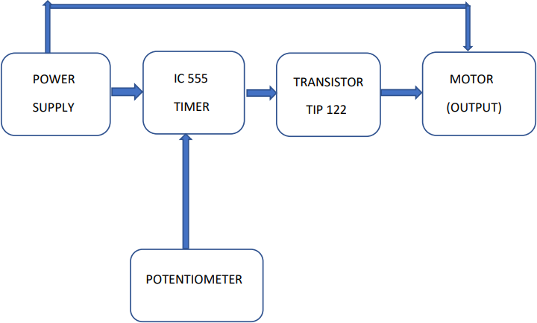
BLOCK DIAGRAM OF OUR PROJECT

Slide 8
COMPONENTS
The method we approached is hardware.
The components used are:
Power supply(battery 9v)
IC 555 timer (Astable mode)
Potentiometer ( 10 kilo ohms )
Transistor (TIP 122)
Motor (6 volts)
Resistor (220K ohms)
Capacitors (100mf, 1mf)
3 Diodes ( two IN418, one IN4007)

Slide 9
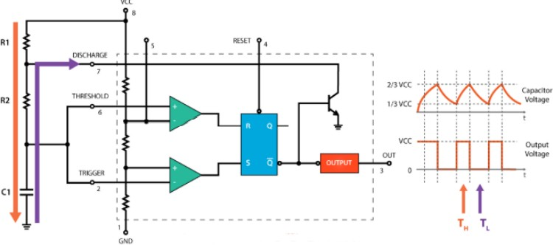
IC 555 TIMER
The 555 generally operates in 3 modes:
1. Astable
2. Mono-stable
3. Bi-stable modes.

Slide 10
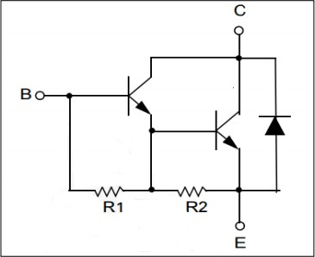
TRANSISTOR
In this circuit, we use TIP122 (Darlington NPN) transistor. The TIP122 is a Darlington pair NPN transistor.
It functions like a normal NPN transistor, but since it has a Darlington pair inside it has a good collector current rating of about 5A and a gain of about 1000.
It can also withstand about 100V across its collector- Emitter hence can be used to drive heavy loads.

Slide 11
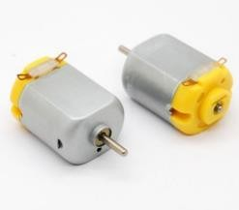
MOTOR
A DC motor is any of a class of rotary electrical machines that converts direct current electrical energy into mechanical energy.
Nearly all types of DC motors have some internal mechanism, either electromechanical or electronic, to periodically change the direction of current flow in part of the motor.

Slide 12
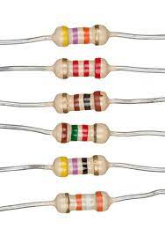
Resistors
A resistor controls the flow of the electrical current within a circuit.
Resistors are made from materials like copper or carbon, which make it difficult for the electrical charges to flow through a circuit.

Slide 13
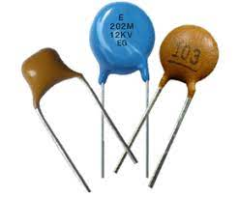
Capacitors
capacitors are widely used in electronic circuits for blocking direct current while allowing alternating current to pass.
In analog filter networks, they smooth the output of power supplies. In resonant circuits they tune radios to particular frequencies.

Slide 14
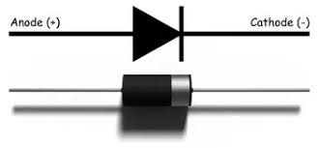
Diodes
diode, an electrical component that allows the flow of current in only one direction. In circuit diagrams, a diode is represented by a triangle with a line across one vertex.
There are various types of diodes, but the ones being discussed here are Zener, Rectifier, Schottky, Transient Voltage Suppressor, Thyristor, Silicon Controlled Rectifier, and TRIAC.

Slide 15
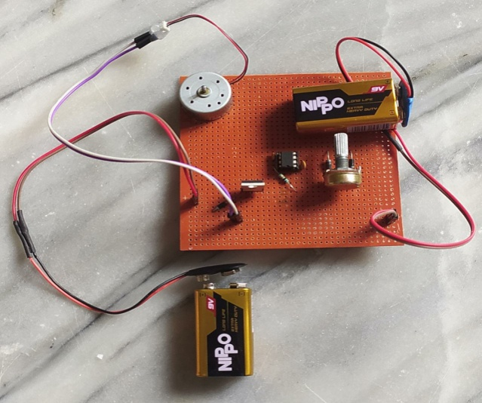
HARDWARE ARRANGEMENT

Slide 16
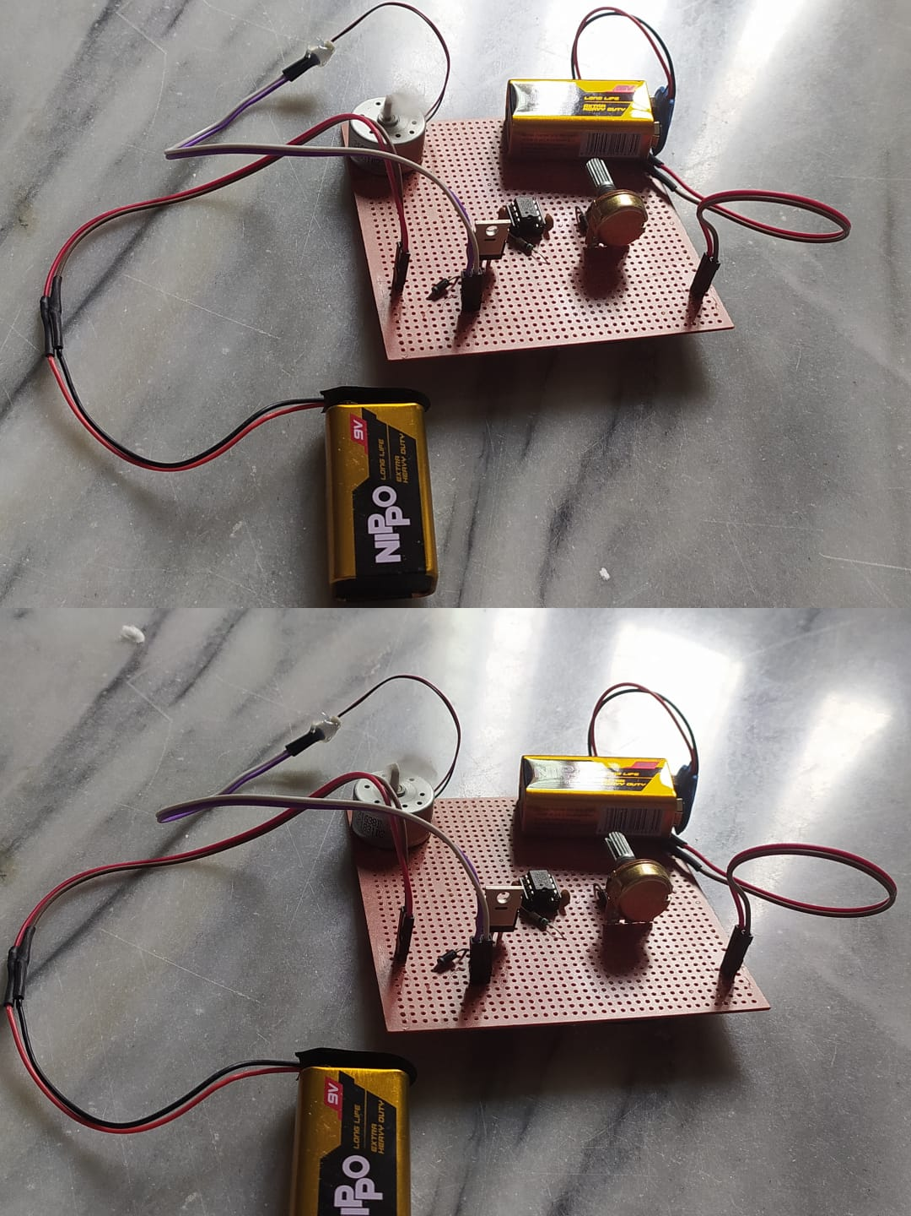
Working:

Slide 17
WORKING:

Slide 18
Conclusion
The dc motor speed is controlled by using power electronic device and the PWM is used to control the speed of dc motor.
The speed pulse train will be based on required input speed.
This circuit is useful to operate the dc motors at required speed with very low heat loss and low cost. The circuit response time is fast.
High reliability can be achieved.
The designed circuit was tested for various speed inputs satisfactorily. The method already employed in traction system and has a good scope ahead.

Slide 19
FUTURE SCOPE
1. DC motor plays a significant role in modern industries. They are widely used in industry because of its low cost, less complex control structure and wide range of speed and torque so better future of this project.
2. In this project we are used pulse width modulation technique, it is a modern technology in solid state field and it provide smooth speed control of motor.
3. Now a day PWM technique are using in fuzzy logic control system, so PWM method is very efficient and reliable method to control the speed of motor so it future is also bright in the modern era with fuzzy logic.

Slide 20
THANK YOU

